Slide 1
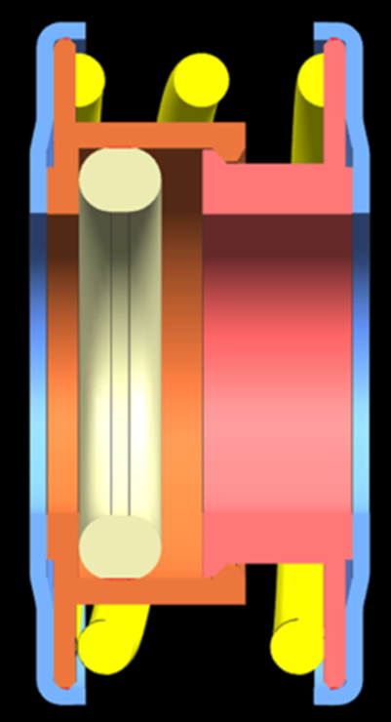
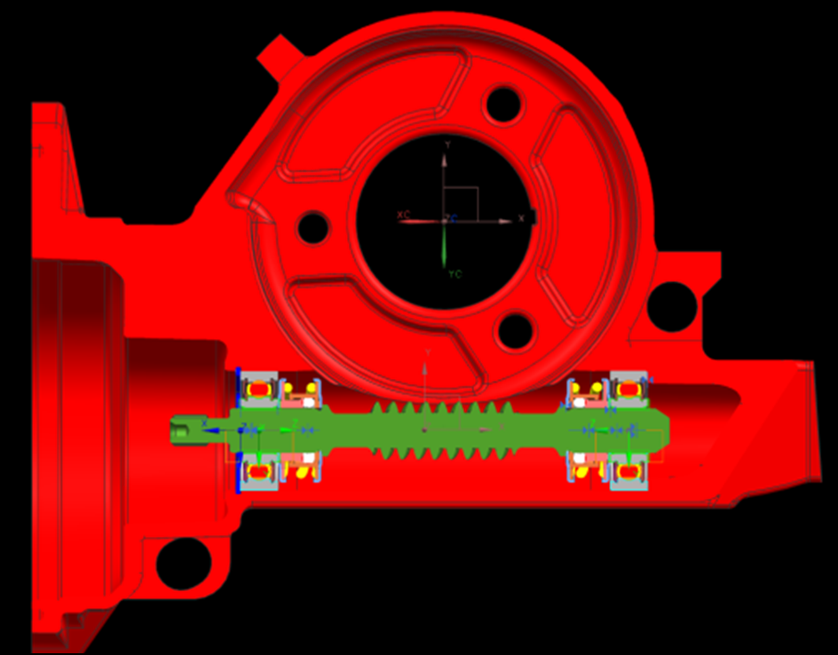
CCM-78: Spring Worm Isolators
Last updated: 03JN15
Description
Implement spring isolators for production
Motivation : 3.0
Deliverables
Fix low temperature reversal clunk issue
Improve robustness (bumper geometry change)
Timing
Make decision on new bumper geometry by June 12th
Prototype bumper by end of July
Team Members/Customers
Team names: Brad Sundholm
Customers: Application Teams

Slide 2
CCM-78: Worm Spring Isolators
Last updated: 03JN15
Status Update:
Supplier Help
Parker Sigma bumper - $0.322
Parker diamond bumper - $0.229
Freudenberg long bumper - $???
Bumper Design Testing
Offset castle design - $???
Test in vehicle at cold temp
Blueprinted Fiat 500 system
Inner Guide Deformation Issue
Amount of overlap between components causing deformation found
Testing ongoing to prevent deformation
Challenges:
Getting reasonable piece price for new bumper design
Determine minimum amount of overlap between components required to hold assembly together
FEA spring rate curve prediction
Next Actions:
Test offset castle bumpers at cold temp in vehicle chamber
Make decision on which bumper design to pursue

